Slide 1

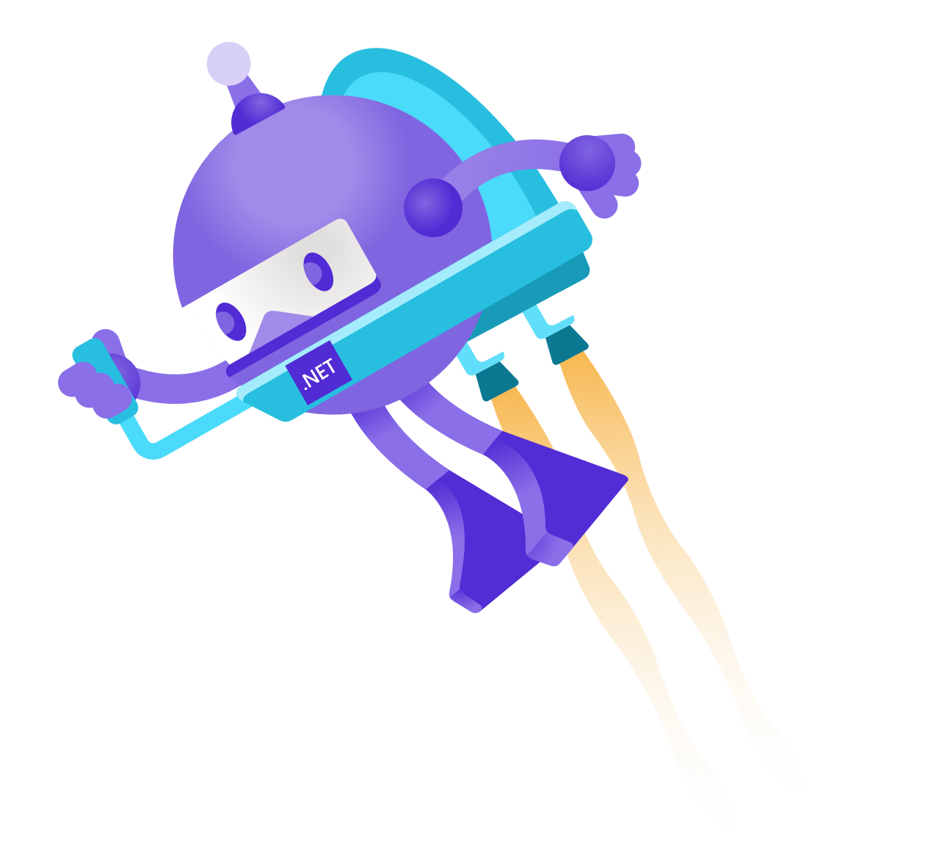
The New & Improved Azure SDK for .NET
Jeffrey Richter Partner Software Architect

Slide 2

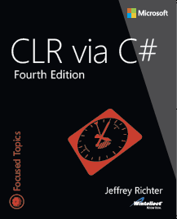
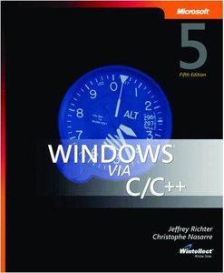
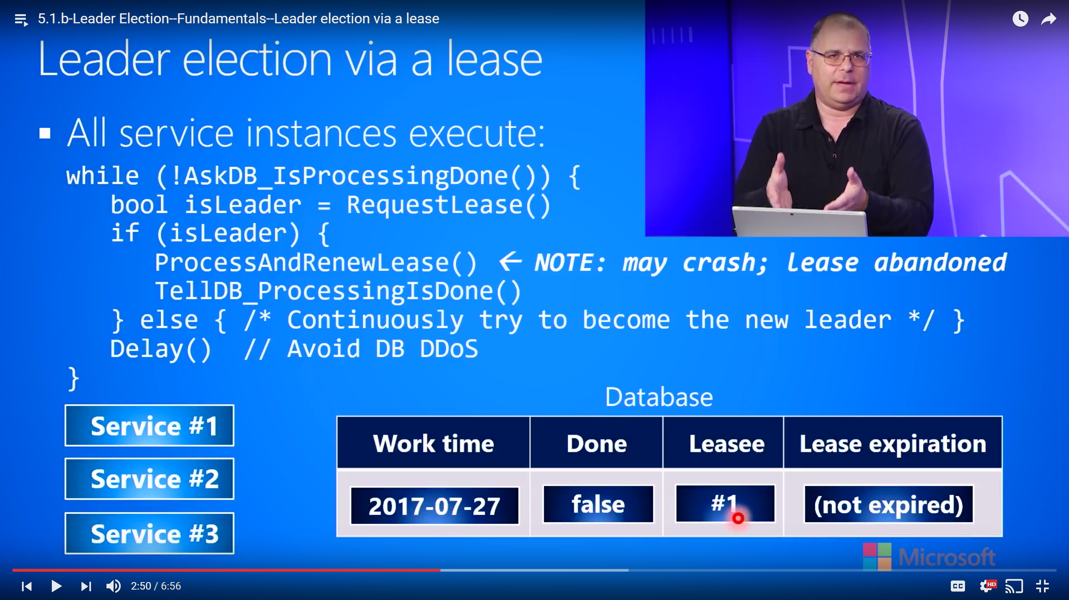




Jeffrey Richter: Microsoft Azure Software Architect, Author & Wintellect Co-Founder
Architecting Distributed Cloud Apps 6.5hr technology-agnostic course
http://aka.ms/RichterCloudApps
JeffRichter@live.com; JeffreyR@Microsoft.com
www.linkedin.com/in/JeffRichter
@JeffRichter
Notes:
Jeffrey Richter: Software Architect, Microsoft Azure
Jeffrey Richter is an Azure Software Architect and authored several best-selling Windows & .NET programming books as well as many MSDN magazine feature articles and columns. He is also a co-founder of Wintellect, a software consulting and training company where he has authored many videos available on WintellectNOW.

Slide 3

The new Azure SDK Guidelines
Idiomatic
Natural language experience and standard package managers
Consistent
Similar experience within and across services and languages
Approachable
Quickly get started, learn, and build
Diagnosable
Easily observe applications
Dependable
High quality, avoid breaking changes
aka.ms/azsdk/guide

Slide 4
Typical Code to make an Azure Service Request
// Create a XxxClient passing URL & credentials
XxxClient client = new XxxClient( new Uri("https://whatever.com/foo/bar"), new DefaultAzureCredential());
// Make service request:
var response = await client.SomeOpAsync(/* … */);

Slide 5
The Extensible HTTP Pipeline
XxxClient method call
Request
Per-Call Policies
Client Request ID
Retry
Authentication
Per-Retry Policies
Logging
Buffer Response
Distributed Tracing
Response
Transport (HttpClient)
Azure Service HTTP API
Notes:
Per-Call
ClientRequestID
Telemetry
Retry
Authentication
PerRetry
Logging
BufferResponse
DistributedTracing
Transport

Slide 6
Demo

Slide 7
Thread Safety & Performance
XxxClient objects are usable by multiple threads simultaneously
After construction, pipelines & the policies we ship are immutable
This also allows multiple clients to share pipelines & policies resulting in efficient memory usage
If you want to make some service requests with different behavior (retry options, different credential, etc.), you just create a new XxxClient object with the options you desire.
One caveat: Credential policies are mutable but still thread safe
Allows your application to update a credential’s password/token on the fly while threads continue to use the pipeline; avoids application downtime

Slide 8

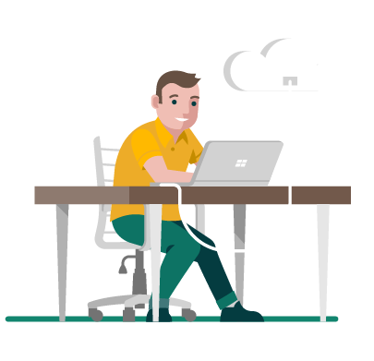

Azure SDK Info
Use and Contribute
Give Feedback
Follow @AzureSDK
Subscribe to Blog
aka.ms/azsdk/releases
aka.ms/azsdk/github
twitter.com/AzureSDK
aka.ms/azsdk/blog
aka.ms/azsdk

Slide 9
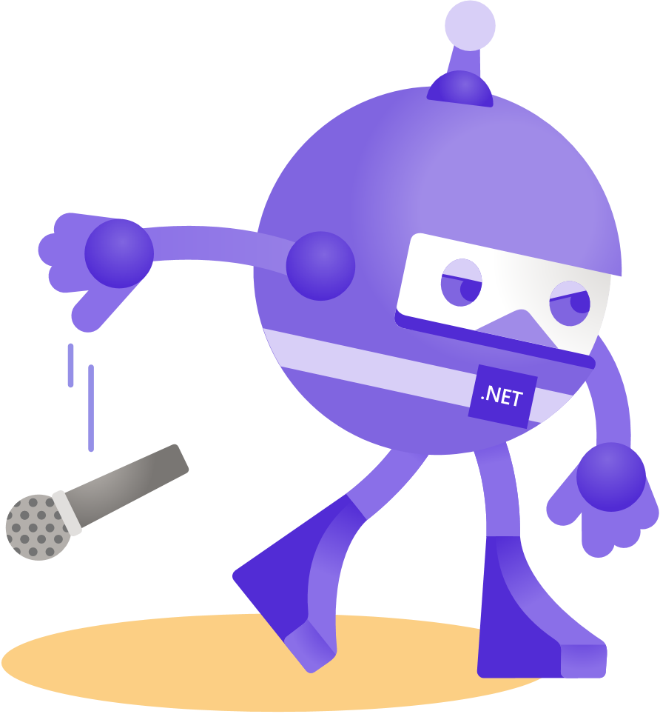
Thanks for joining!

